Slide 1



PLEASE CLICK KEYPAD OR MOUSE TO ACTIVATE VIDEO SLIDESHOW
5
Top job application tips
CLICK HERE

Slide 2

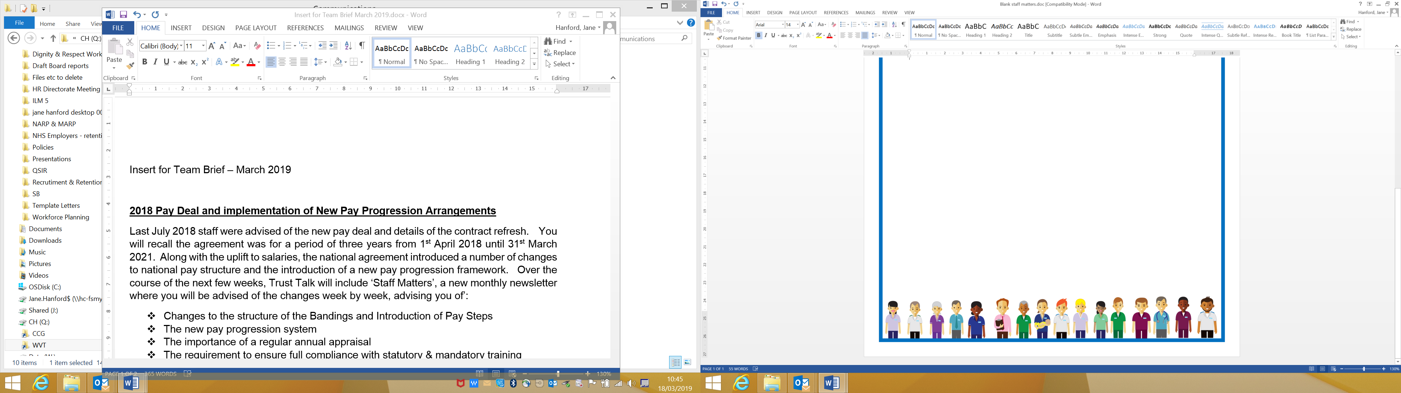
1
Keep it relevant

Slide 3

Get to know the competencies and essential criteria required for the role
And demonstrate how you meet them in your application.

Slide 4

2
Provide strong supporting information

Slide 5

This is your chance to sell yourself!
Include all relevant skills, experiences and qualifications

Slide 6

3
Showcase your transferrable skills

Slide 7
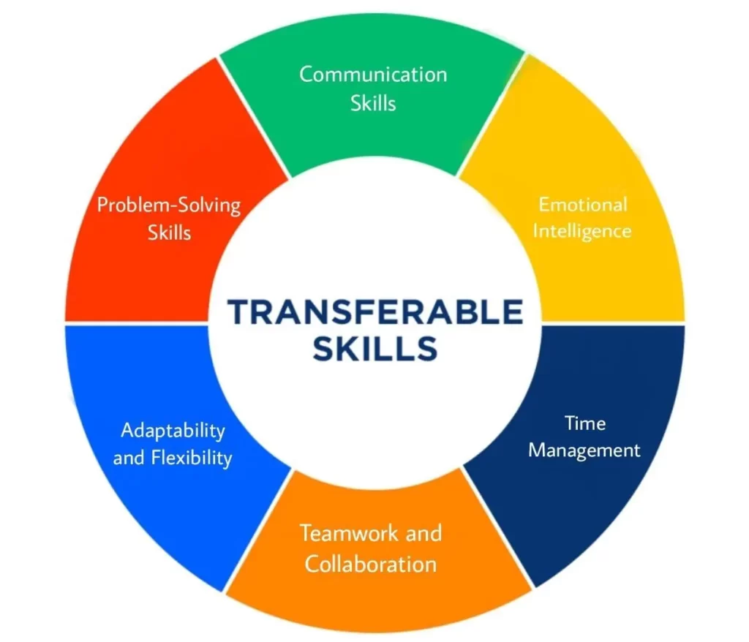
Think about key skills like communication, team work and problem solving
Provide specific examples from your past to show how you have used these skills.

Slide 8


4
Take your time.

Slide 9

Job hunting can be hard work and time consuming
Spend time on your application, read it through thoroughly and don’t rush.

Slide 10

5
Pay attention to detail

Slide 11

Double check spelling and grammar before submitting.
Even better get a friend or family member to read it for you.

Slide 12
Good Luck

